Slide 2
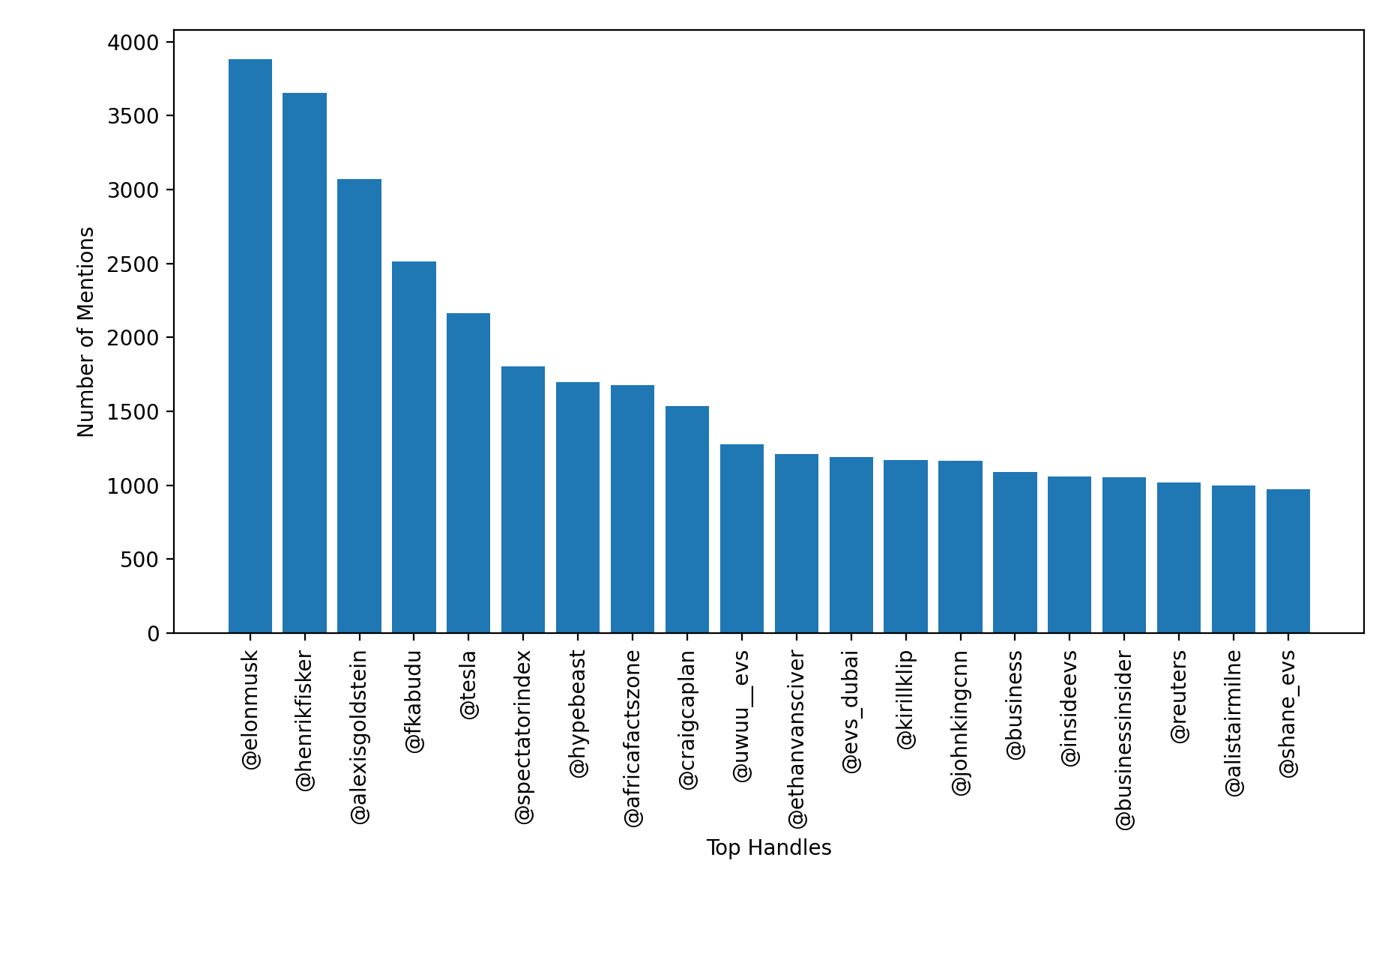
2020 In Mentions
Chairman TNR Gold + EV blogger
C-Span Producer
Influencer
Global men’s contemporary fashion retailer
CEO of Fisker
Ex Wall Street VP, senior policy advisor Americans for financial reform
Global factual content provider
CNN Anchor
Investor/entrepreneur, focused on tech

Slide 3
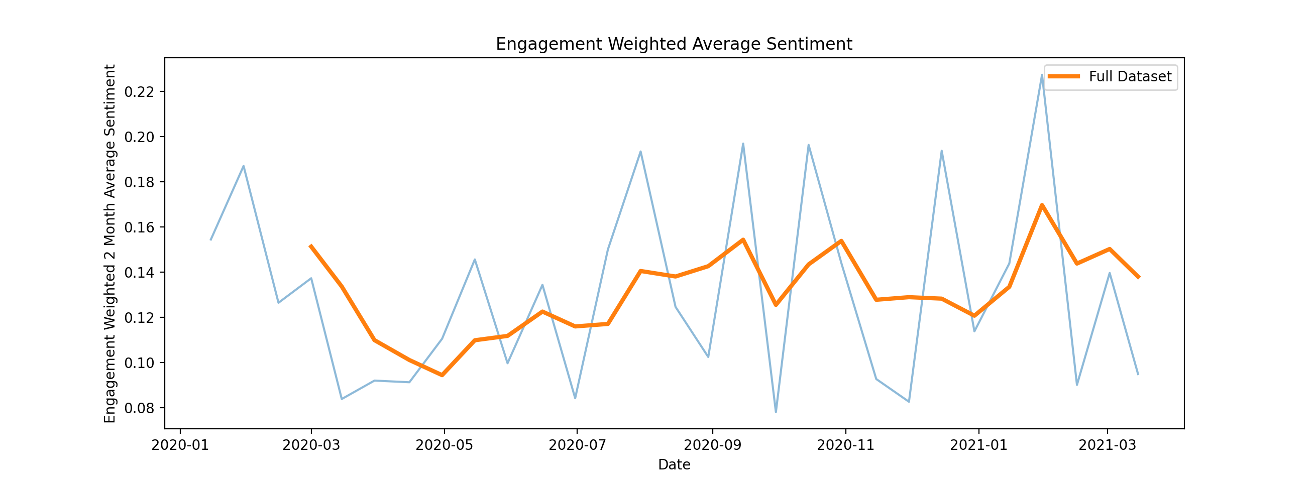
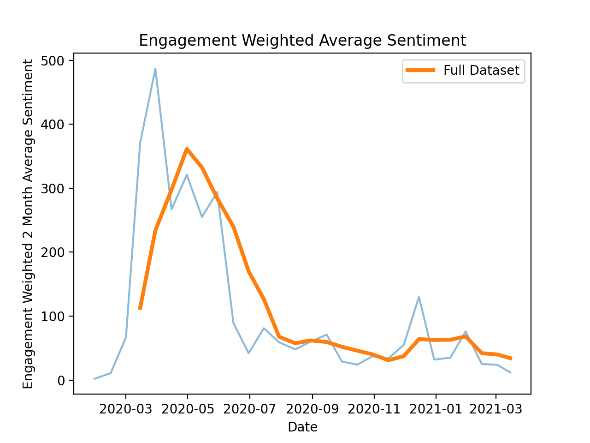
2020 Sentiment Trend
Nissan Sunderland score
Engagement weighted sentiment score (2 month rolling average)
Sentiment consistently above 1 (=positive)
Q1 2020 - > dip (general decline due to
Avg score for ICE ban set less than baseline
Avg score for Nissan Sunderland dataset greater than baseline
Next steps:
Investigate why we see these trends
Compare promoters/detractors
ICE Ban
Tweets mentioning covid

Slide 4
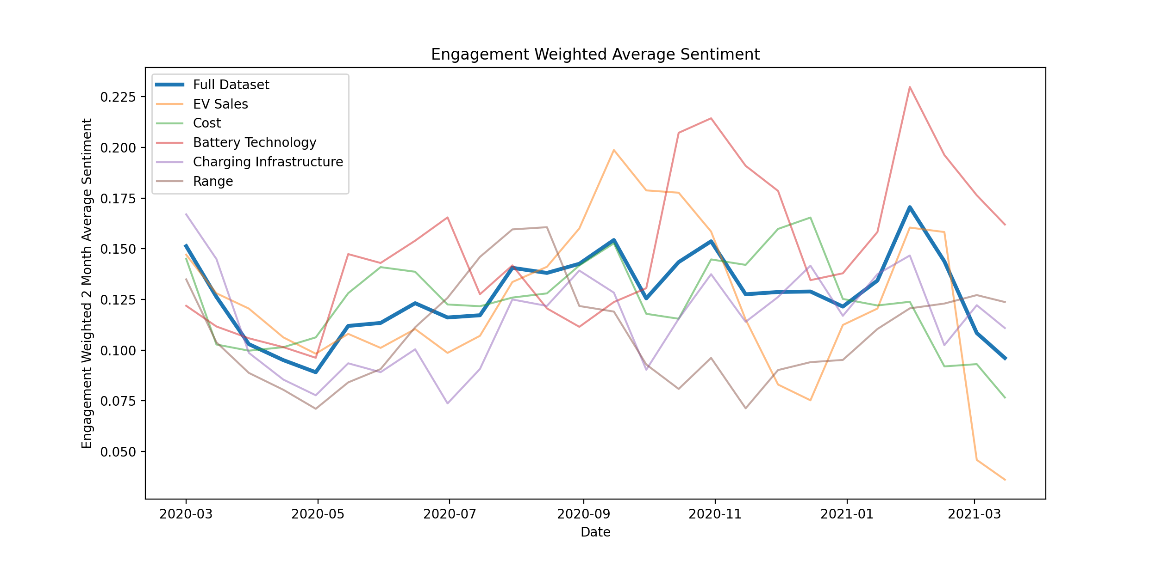
2020 Sentiment Trend By Topic
Q12020 dip is consistent across topics, reinforcing suggestion around COVID pandemic
Initial pickup driven by EV sales and Range and Battery Tech
Battery technology consistently most positive
Range (mostly) consistently the lowest
EV sales dives in March 2021

Slide 5
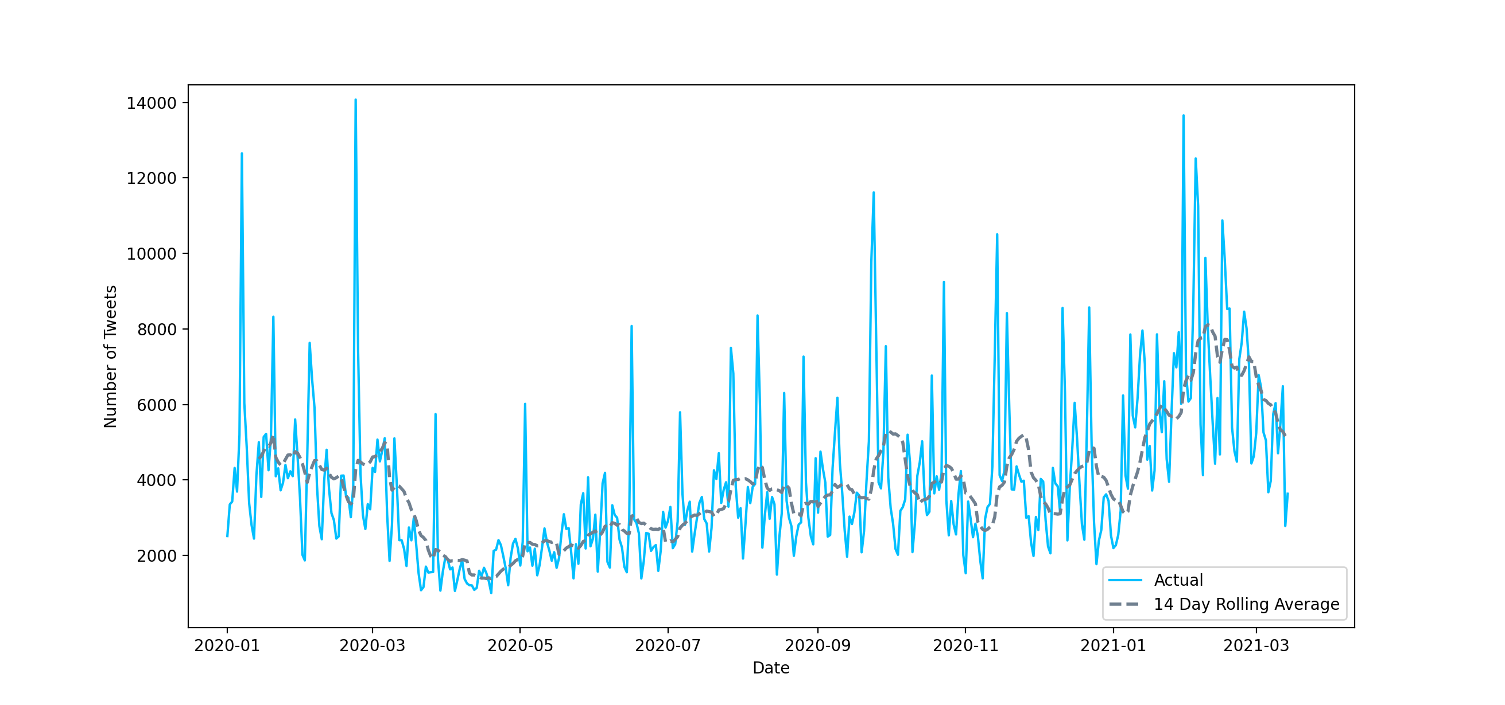
Tweets Mentioning Electric Vehicles
California announce ban of Gas-Powered vehicles effective 2035
Musk surpasses Bezos as world’s richest person
Tesla Model S Becomes First 400-Mile Electric Vehicle
BMW Announce Electric 5 and 7 Series
UK Gov announces 2030 ICE ban
GM pledges all electric by 2035
Biden exec order pledging to make all federal vehicles electric
Musk tweets wipes $14bn of Tesla value
Tesla surpasses Toyota in market capitalization
Jaguar announce plans to be fully electric by 2025
Tesla invest $1.5bn in bitcoin
US Re-joins Paris Climate Agreement
Macron announces rescue plan for French automotive industry
Total number of tweets containing ‘electric car’ or electric vehicle’ across twitter archive, for charted dates. Includes tweets since deleted.
COVID-19 declared a pandemic
Biden Elected
US President
Biden Inaugurated

Slide 6
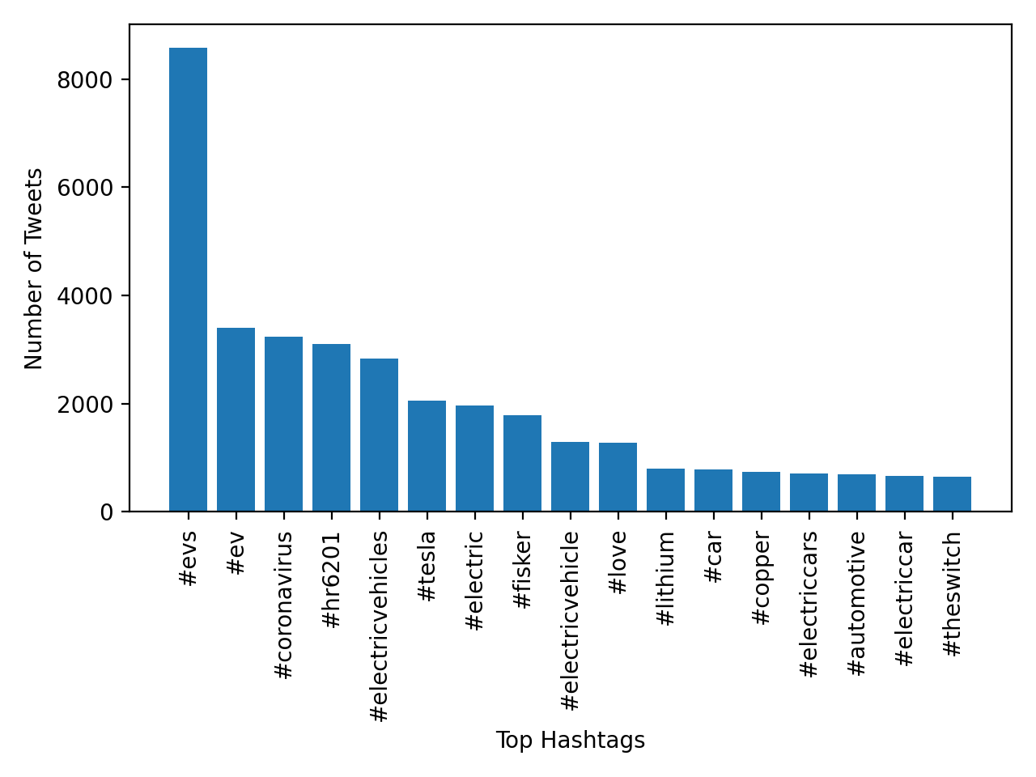
2020 in Hashtags
Tesla and Fisker most prevalent brands picked up in samples.
Noise related to COVID and US response to COVID
Battery tech/raw material focused hashtags among most prevalent:
Lithium
Copper
#theswitch forum discussing/encouraging switching away from ICE vehicles

Slide 7
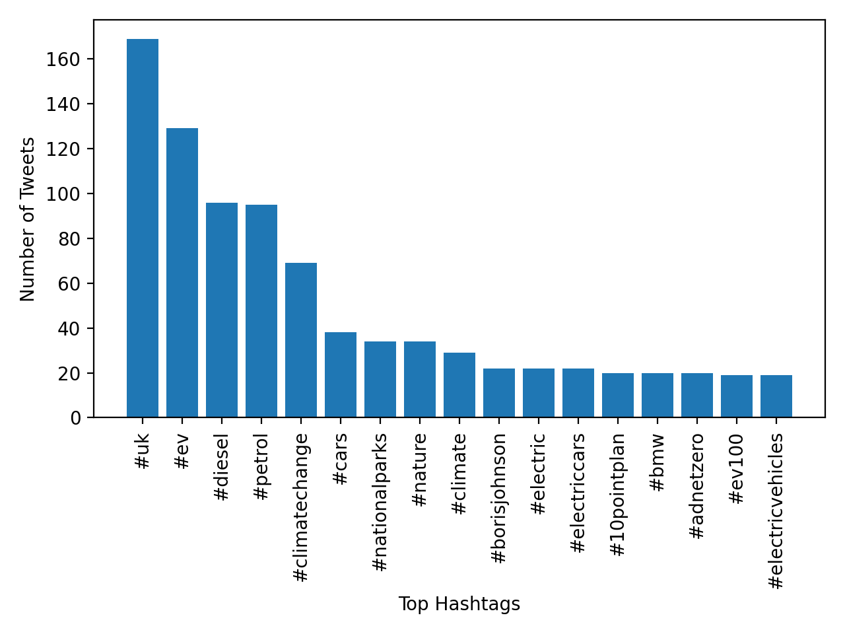
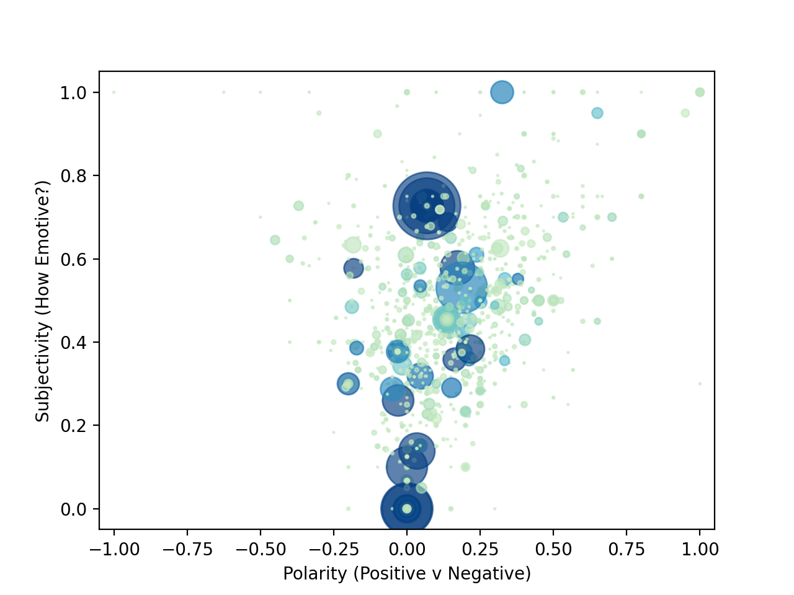
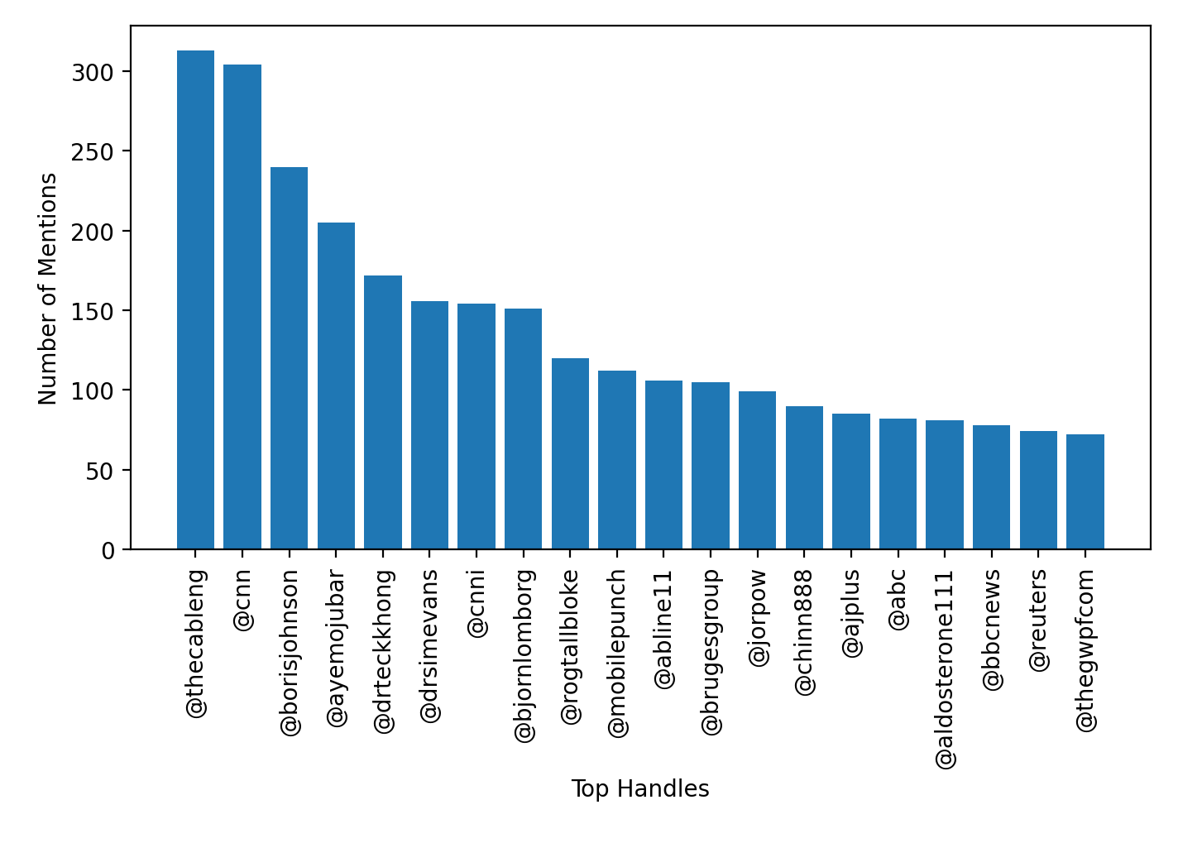
ICE Ban Initial Results
Highlights – sentiment skewed positive, not as much as Nissan dataset,
below 2020 baseline.
To-Do: topic models + maps + link back to 2020 trend

Slide 8
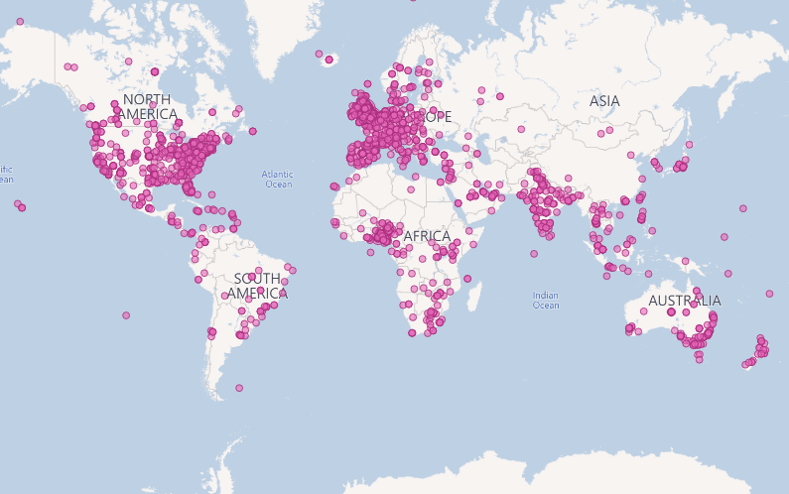
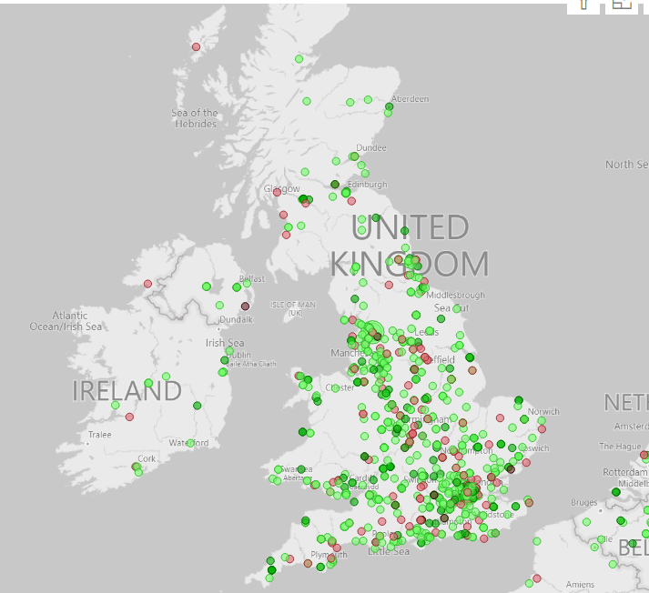
British Isles:
Most activity in urban areas + South
Comparatively low in NI/Scotland
Highest sentiment focused in London, midlands + cities
Worldwide response:
Concentrated in urban conurbations in developed countries.
Developing world: mostly Nigeria, SA and India

